Slide 1
PSYC 496/521
Lecture 3: Arguments, Fallacies, and Deductive Logic

Slide 2

Philosophy Week
We take philosophy for granted now, because much of it has just become a part of human culture the world over.
Early Greek philosophy explored many questions, falling into four categories
How the world is
Physics: the nature of things. Also called ”natural philosophy”, and eventually “science”
Metaphysics: literally “after physics”. Foundational topics involving primitive units of the universe, nature of time, space, mind, and God.
How the world ought to be
Ethics: how one should live or behave
Aesthetics: what makes something have value
How should we go about answering these kinds of questions?
Logic: the art of reasoning
How do we know our answers and methods are correct?
Epistemology: the study of knowledge

Slide 3
Philosophy Week
Knowledge is a true belief with a logos, a reason or explanation.
No longer acceptable:
Appeal to authority, accomplishment, loyalty, faith, or divine insight
Appeals to common sense, tradition, normality, or popularity
Appeals to emotion
Ad hominem criticism (attacks on the credibility of the person)
Instead, arguments based on reasons

Slide 4

Arguments
Argument: A collection of propositions called premises (P₁, P₂, …P_{N}) put forward by a reasoner (R) providing independent support of a proposition called the conclusion (C)

Slide 5
Arguments
Arguments come in (at least) two types: deductive & inductive
Deductive arguments: the conclusion is no broader than the premises (i.e. non-ampliative). The conclusion is contained within, or follows from, the premises.
[1] Jon is not happy unless he has had pizza within 72 hours
[2] Jon has not had pizza in 5 days
∴ [3] Jon is not happy

Slide 6
Arguments
Arguments come in (at least) two types: deductive & inductive
Inductive arguments: the conclusion is broader than the premises (i.e., non-ampliative). The conclusion is not contained within, or does not follow from, the premises.
[1] The sun has risen every day before today
∴ [2] The sun will rise tomorrow as well
Deductive is broad to narrow. Inductive is narrow to broad.

Slide 7
Arguments
Deductive arguments
that is well-grounded (i.e., has true premises that are clear and well defined) is valid (i.e., follows the rules of logic) is guaranteed to have a true conclusion.
Arguably cannot generate genuinely new knowledge
Inductive arguments
can generate truly new knowledge
give us no guarantees. A good inductive argument can give us a high probability of a true conclusion, but that is all.

Slide 8
Arguments
We call an argument “sound” if it is both valid (well-formed) and grounded.
In order to evaluate arguments, we need procedures for determining validity and groundedness.
Formal Logic: The study of argument validity. Focus is on the form of the argument, not its content.

Slide 9

Fallacies
Fallacy: a reasoning error that creates an unsound argument that nonetheless sounds attractive to our mind.
These can affect both the groundedness and the validity (form) of the argument.

Slide 10
Circular Argument
Fallacies
[1] My name is Jon
∴ [2] My name is Jon
Circular argument: an argument where the conclusion is also one of the premises
Circular arguments are valid (if we assume premise is true, conclusion must be true)
Premise does not provide independent support of the conclusion
Are the following circular arguments?
Murder is wrong because killing people is immoral
Using drugs is bad because drug use is harmful
It is wrong to kill animals because it is wrong to kill anything that can feel pain.

Slide 11
Fallacies
Begging the Question
Begging the question: any argument where the conclusion is being used in support of itself.
Circular arguments
Leading questions
Taking advantage of assumptions or connotations
You’re not going to wear that, are you?
Do I look good in this outfit?
Trying to get good grades, but don’t have a lot of time? Try my app called “Time Saving Studier”!
Notes:
People often misuse “begging the question” when they mean to say “that leads one to ask the question”. In logic, begging the question specifically means any argument where the conclusion is being used in support of itself and no independent reason is given.

Slide 12
Fallacies
Equivocation
Equivocation: taking advantage of ambiguity to change the meaning of a word within an argument
[1] Tables are furniture
[2] My statistics book has tables in it
∴ [3] There is furniture in my statistics book
[1] We have a right to vote
[2] We should always do what is right
∴ [3] We should always vote

Slide 13
Fallacies
Distinction without a difference
Distinction without difference: when we try to draw a distinction between two things that are not actually distinct.
I didn’t steal it, I just borrowed it.

Slide 14
Appeal to Authority, Common Belief, Tradition
Fallacies
Is appealing to an authority always a fallacy? If so, why are you listening to me?
What makes someone a legitimate authority? Three requirements
The person must exist (No “I heard somewhere that…”)
The person is actually an expert (is in a position to know the answer)
The person must not have a stake in you believing one way or the other
Appeals to common and tradition are like appeals to authority:
Is “the crowd” in a better position to know than you?
Are they committing fallacies to believe what they do?
Are they (consciously or not) invested in what you believe?
Often a form of begging the question, not providing independent evidence

Slide 15
Fallacies
Arguing by (Bad) Analogy
Another flawed version of a good form of reasoning
Successful analogies involve structural similarities between two systems. An analogy can go wrong if that structural similarity is missing.
[1] Elon Musk was successful in business
∴ [2] Elon Musk will be a good politician
[1] Elon Musk was successful in business
[2] Being successful in business and politics involve the same skills
∴ [3] Elon Musk will be a good politician

Slide 16
Fallacies
Fallacies of Causation
Post hoc fallacy: Post hoc, ergo proper hoct, After this, therefore because of this
Neglecting of a common cause fallacy
Causal oversimplification: A+B+C+D…→Z != A→Z
Confusion of necessary with sufficient conditions: A→B != B→A
Slippery slope fallacy: A→B→C→D

Slide 17
Fallacies
Fallacies of Irrelevance
Ad hominem: “to the man”. Don’t listen to him/her, they are an X.
Tu Quoque: “but you do it too”
Don’t trust him, it’s in his interest for you to believe them
Attacking a Straw Man: violating the principle of charity (i.e., assess the strongest possible version of an argument).
Arguments that alter the score of the premises or conclusion
Arguments that replace premises: “the real reason…"
Red Herring: an argument that replaces an argument’s conclusion
“Abortion restrictions are an affront freedom, to womens’ right to control their own bodies”. “Oh, that’s funny, coming from someone who wants to take away everyone’s guns.”

Slide 18
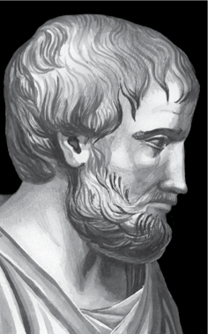
Formal Logic: Aristotle
Formal logic examines what propositions necessarily follow from what other propositions because of their forms, regardless of their content
Propositions: declarative sentences that have a subject and a predicate, the thing that we are asserting about the subject.
All dogs have tails. Fido is a dog. Therefore. Fido has a tail.
All dogs have tails. Max has a tail. Therefore, Max is a dog.
All X’s have F.
x is a n X
Therefore, x has F.
All X’s have F.
x has an F.
Therefore, x is an X.
Aristotle
384-322 BCE
Notes:
We have learned that there are two criteria for acceptable arguments: well-groundedness and validity. You have also seen that there are two types of arguments: inductive and deductive. So far, you have examined some aspects of informal logic—that is, analysis of the well-groundedness of arguments—and you have looked at validity concerns for inductive arguments. What remains is deductive validity, the aspect of logic that has historically commanded a great amount of attention from logicians. In this lecture, you will be introduced to formal logic.

Slide 19
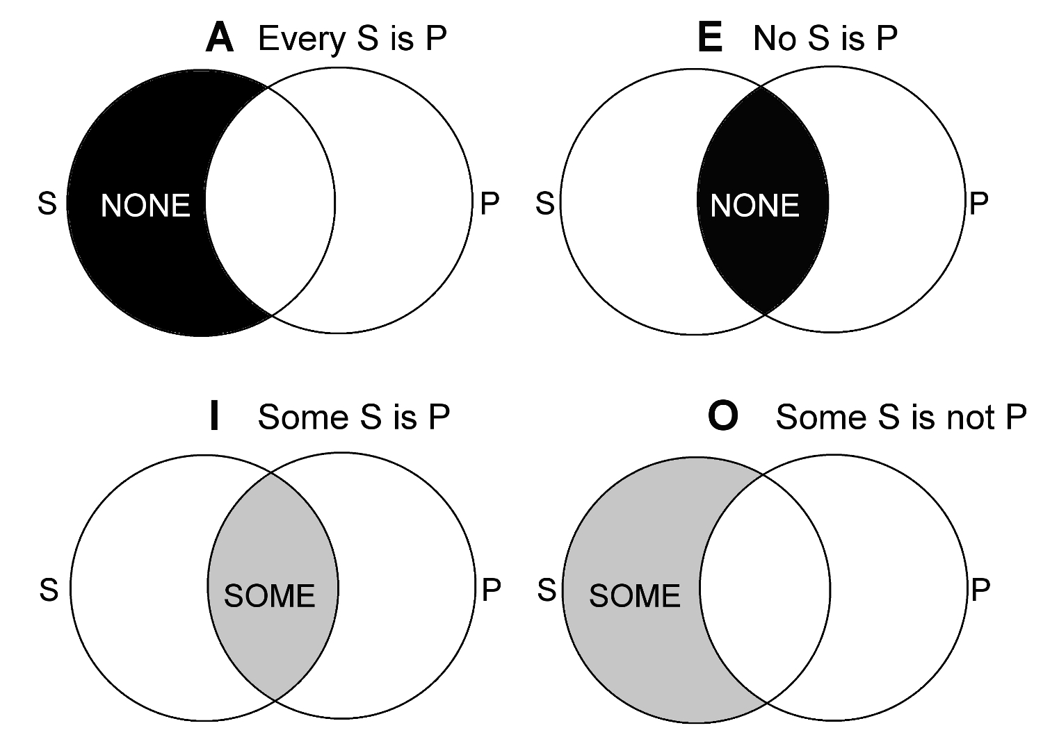
Formal Logic: Aristotle
Aristotle’s categorical propositions:
A proposition is true iff (if and only if) the subject has the property asserted by the predicate and is false if not. Four types of categorical propositions, presented in Aristotle’s “square of opposition”
Contradictories:
Opposite corners are negations, as in A is true iff O is false, and I is true iff E is false
Universal
Contraries:
A and E sentences cannot both be true, but can both be false
Affirmative
Negative
Subcontraries:
I and O sentences can both be true, but cannot both be false
Aristotle
384-322 BCE
Particular

Slide 20
Formal Logic: Aristotle
Existential vs. Hypothetical
What about “All unicorns have a horn”
Universal
Hypothetical:
If there are unicorns, they have a horn
Affirmative
Negative
Existential:
There is at least one unicorn, and it has a horn
Aristotle
384-322 BCE
Particular

Slide 21
Formal Logic: Aristotle
Categorical Syllogisms: arguments with a categorical sentence as a conclusion and two categorical sentences as premises
[1] All humans are mortal [2] All Greeks are human
∴ [3] All Greeks are mortal
P: The predicate of the conclusion, the major term S: The subject of the conclusion, the minor term M: The middle term, the term in both premises but not the conclusion Major premise: P+M Minor premise S+M
[1] M P [2] S M
∴ [3] S P
Aristotle
384-322 BCE

Slide 22
Formal Logic: Aristotle
Categorical Syllogisms: arguments with a categorical sentence as a conclusion and two categorical sentences as premises
[1] All humans are mortal [2] All Greeks are human
∴ [3] All Greeks are mortal
[1] M P [2] S M
∴ [3] S P
[1] All Greeks are human [2] All mortals are human
∴ [3] All mortals are Greek
[1] P M [2] S M
∴ [3] S P
[1] All Greeks are human [2] All humans are mortal
∴ [3] All mortals are Greek
[1] P M [2] M S
∴ [3] S P
[1] All humans are Greek [2] All humans are mortal
∴ [3] All mortals are Greek
[1] M P [2] M S
∴ [3] S P
[1] All humans are mortal [2] All Greeks are human
∴ [3] No Greeks are mortal
[1] A: M P [2] A: S M
∴ [3] E: S P
[1] All humans are mortal [2] No Greeks are human
∴ [3] Some Greeks are not mortal
[1] A: M P [2] E: S M
∴ [3] O: S P
Aristotle
384-322 BCE
There are four moods (A,E,I,O), and three orders, so 4^3=64 possible combinations
Times our 4 possible arrangements of terms within the premises: 256 combinations

Slide 23
Formal Logic: Aristotle
Aristotle’s five simple rules
Distributed term: is it referring to an entire class of entities.
In A and E sentences the subjects are distributed
In I and O sentences they are not
O sentences distribute the predicate
A: All Greeks are human
E: No Greeks are human
I: Some Greeks are human
O: Some Greeks are not human (the entire set of humans fails to include some Greeks)
Aristotle
384-322 BCE

Slide 24
Formal Logic: Aristotle
Aristotle’s five simple rules
In all valid syllogisms:
the middle term is distributed in at least one of the premises
any term distributed in the conclusion is also distributed in the premises
at least one of the premises must be affirmative
If the conclusion is negative, one premise must be negative
If the conclusion is particular, at least one of the premises must be particular (for hypothetical viewpoint only, for existential, only use the first four)
A syllogism is valid iff it follows all five of these rules
Aristotle
384-322 BCE

Slide 25


Formal Logic: Aristotle
Aristotle’s five simple rules
the middle term is distributed in at least one of the premises
any term distributed in the conclusion is also distributed in the premises
at least one of the premises must be affirmative
If the conclusion is negative, one premise must be negative
If the conclusion is particular, at least one of the premises must be particular (for hypothetical viewpoint only, for existential, only use the first four)
Middle Term (M)
Major Term (P)
Minor Term (S)
[1] All humans are mortal [2] All Greeks are human
∴ [3] All Greeks are mortal
[1] M P [2] S M
∴ [3] S P
Aristotle
384-322 BCE
[1] All Greeks are human [2] All humans are mortal
∴ [3] All mortals are Greek
[1] P M [2] M S
∴ [3] S P

Slide 26
Formal Logic: Truth Functional Logic
Philosophy and science must be done with words, but words are ambiguous and vague
Develop an artificial language, one with exactitude required built into its very grammatical structure
The syntax makes false statements impossible
Get the syntax right, and the semantics takes care of itself
By translating natural languages into this language, we could see whether they were real questions and determine their truth conditions
The German mathematician/logician/philosopher Gottlob Frege called his attempt at framing such a language Begriffschrift, or concept writing. It ultimately became truth-functional logic.
1

Slide 27
Formal Logic: Truth Functional Logic
Function here means same thing as in math
y = f(x) means for every value of x there is a unique value of y
Takes in an input and spits out something well defined
But instead of numbers, truth values T and F
The goal in truth functional logic is to figure out, if we know the truth value of a particular sentence, what other sentences have to be true or false?
As with Aristotle, goal is for rules that are concerned with the form, content is irrelevant
1

Slide 28
Formal Logic: Truth Functional Logic
Truth functional logic has two elements
Atomic sentences: Simple declarative sentences
Truth functional connective: a word that joins atomic sentences
The sky is blue AND I was born in 1872
A connective is truth functional iff the truth of the joined sentence can be determined as a function of its parts and the value of the connective
1

Slide 29
Formal Logic: Truth Functional Logic
Truth functional connectives can be defined in truth tables
P | Q | P and Q
T | T | T
T | F | F
F | T | F
F | F | F
1

Slide 30
Formal Logic: Truth Functional Logic
Not all connectives are truth functional
P | Q | P because Q
T | T | ?
T | F | ?
F | T | ?
F | F | ?
1
P: The sky is blue
Q: Einstein was a physicist
P BECAUSE Q: The sky is blue because Einstein was a physicist
Notes:
The sky is blue BECAUSE Einstein was a physicist

Slide 31
Formal Logic: Truth Functional Logic
Truth functional connectives can be defined in truth tables
P | -P
T | F
F | T
P | Q | P & Q
T | T | T
T | F | F
F | T | F
F | F | F
1
P | Q | P ∨ Q
T | T | T
T | F | T
F | T | T
F | F | F
P | Q | P → Q
T | T | T
T | F | F
F | T | T
F | F | T

Slide 32
Formal Logic: Truth Functional Logic
Truth functional connectives can be defined in truth tables
P | Q | P → Q
T | T | T
T | F | F
F | T | T
F | F | T
1
Why are the last two rows true?
P There is an elephant in the classroom next Thursday
Q I will give you $10000
If there is an elephant in the classroom next Thursday, I will give you $10000
Was the promise kept? (T)
Do you have a reason to complain? (F)

Slide 33
Formal Logic: Truth Functional Logic
Truth tables can be used to express more complex arguments
P | Q | P & Q | -P | (P&Q) ∨ -P
T | T | T | F | T
T | F | F | F | F
F | T | F | T | T
F | F | F | T | T
1

Slide 34
Formal Logic: Truth Functional Logic
Types of truth functional sentences (or sets of sentences)
Tautology: sentence that is always true It is hot in here or it is not hot in here
Contradiction: sentence that is always false It is hot in here and it is not hot in here
A Contingency: a sentence whose truth value depends on some state of the world
2

Slide 35
Formal Logic: Truth Functional Logic
Equivalence: When two sentences have the same truth values regardless of the state of the world
Is –a&-b equivalent to –(a&b)?
a: I have cream in my coffee
b: I have sugar in my coffee
2
a | b | -a | -b | -a&-b
T | T | F | F | F
T | F | F | T | F
F | T | T | F | F
F | F | T | T | T
a | b | a&b | -(a&b)
T | T | T | F
T | F | F | T
F | T | F | T
F | F | F | T
I don’t have sugar in my coffee and I don’t have sugar in my coffee
I don’t have sugar or cream in my coffee

Slide 36
Formal Logic: Truth Functional Logic
Consistency: If it is possible for two sentences to be true at the same time
Weak (“The sky is blue” and “I am a warthog” are consistent)
s: The sky is blue
w: I am a warthog
2
s | w | -w
T | T | F
T | F | T
F | T | F
F | F | T
s is consistent with anything except -s

Slide 37
Formal Logic: Truth Functional Logic
Implication: A sentence S1 truth-functionally implies S2 iff whenever S1 is true, S2 is also true
Not the same as equivalence (all the same truth values).
2

Slide 38
Formal Logic: Truth Functional Logic
Truth tables and validity
An argument is valid iff its premise set implies its conclusion
Just make a big truth table, and if all cases where all premises are true, the conclusions are true, the argument is valid
2

Slide 39
Formal Logic: Truth Functional Logic
Truth tables and validity
Example Modus Ponens
2
[1] m → n [2] m
∴ [3] n
m | n | m→n
T | T | T
T | F | F
F | T | T
F | F | T
m→n | m | n
T | T | T
F | T | F
T | F | T
T | F | F

Slide 40
Formal Logic: Truth Functional Logic
Truth tables and validity
The fallacy of affirming the consequent
2
[1] m → n [2] n
∴ [3] m
m | n | m→n
T | T | T
T | F | F
F | T | T
F | F | T
m→n | n | m
T | T | T
F | F | T
T | T | F
T | F | F

Slide 41
Formal Logic: Truth Functional Logic
Three atomic sentences
If there is precipitation and the temperature is below freezing, then there is snow. There is not not snow or the temp is below freezing. Therefore, there is precipitation or there is snow.
2
a: there is precipitation
b: it is below freezing
c: there is snow
a | b | c | a&b | (a&b)→c | -c | -c V b | a V c
T | T | T | T | T | F | T | T
T | T | F | T | F | T | T | T
T | F | T | F | T | F | F | T
T | F | F | F | T | T | T | T
F | T | T | F | T | F | T | T
F | T | F | F | T | T | T | F
F | F | T | F | T | F | F | T
F | F | F | F | T | T | T | F
[1] (a&b)→ c [2] –c ∨ b
∴ [3] a ∨ c

Slide 42
Formal Logic: Truth Functional Logic
[1] a→b [2] b→c [3] c→d [4] d→e [5] e→f [6] f→g [7] a
∴ [8] g
2

Slide 43
Formal Logic: Truth Functional Logic
Natural Deduction
Another, more powerful method for determining if arguments are logical
Think of deduction like a game.
The board is three columns
C1: Positive integers in ascending order, each line has a number
C2: Nothing but true sentences written in our truth functional language
C3: The justification that allowed a sentence to be placed in C2
We start with our premises as the first rows, with “premise” written as their justification in C3.
We are then trying to transform rows, using allowed transformation rules, until we arrive at our conclusion. If we succeed, valid argument.
3
Notes:
Why introduce a second validity test when we already have a perfectly good one? Truth tables are not always user-friendly, and our truth-functional language is insufficient for all of the logical work we want to do.

Slide 44
Formal Logic: Truth Functional Logic
[1] a→b [2] b→c [3] c→d [4] d→e [5] e→f [6] f→g [7] a
∴ [8] g
3

Slide 45
Formal Logic: Truth Functional Logic
line | S | justification
1 2 3 4 5 6 7 | a→b b→c c→d d→e e→f f→g a | premise premise premise premise premise premise premise
[1] a→b [2] b→c [3] c→d [4] d→e [5] e→f [6] f→g [7] a
∴ [8] g
3

Slide 46
Formal Logic: Truth Functional Logic
line | S | justification
1 2 3 4 5 6 7 8 9 10 11 12 13 | a→b b→c c→d d→e e→f f→g a b c d e f g | premise premise premise premise premise premise premise MP1,7 MP2,8 MP3,9 MP4,10 MP5,11 MP6,12
[1] a→b [2] b→c [3] c→d [4] d→e [5] e→f [6] f→g [7] a
∴ [8] g
3

Slide 47
Formal Logic: Truth Functional Logic
The rules of inference
Rule | Premise 1 | Premise 2 | Premise 3 | Conclusion
Modus Ponens (MP) | A→B | A |  | B
Modus Tonens (MT) | A→B | -B |  | -A
Hypoth. Syllogism (HS) | A→B | B→C |  | A→C
Conjunction (Conj) | A | B |  | A&B
Simplification (Simp) | A&B |  |  | A
Addition (Add) | A |  |  | AvB
Disjunctive Syllogism (DS) | AvB | -A |  | B
Constructive Dilemma (CD) | A→B | C→D | AvC | BvD
3

Slide 48
Formal Logic: Truth Functional Logic
The rules of inference
Rule | Premise 1 | Conclusion | Premise 1 | Conclusion
Double Negation (DN) | A | - - A
DeMorgan’s Theor. (DeM) | -(AvB) | -A&-B | -(A&B) | -Av-B
Distributive (Dist) | Av(B&C) | (AvB) & (AvC) | A&(BvC) | (A&B) v (A&C)
Associative (Assoc) | Av(BvC) | (AvB)vC | A&(B&C) | (A&B)&C
Commutative (Comm) | AvB | BvA | A&B | B&A
Contradiction (Contra) | A→B | -B→-A
Exportation (Exp) | (A&B)→C | A→(B→C)
Implicature (Impl) | A→B | -AvB
Tautology Taut) | AvA | A | A&A | A
3

